Slide 1

The Nelson Mandela African Institution of Science and Technology
Course Name: Research Methods and
Communication
Course Code: 6001
(Lecturer: Elizabeth Mkoba, PhD)
Learning Unit 1: Fundamentals of Research

Slide 2
Read This Slowly by Jakewoodard
“The Universe responds to your frequency. It does not recognize your personal desires, wants or needs. It only understands the frequency in which you are vibrating at.
For example,
If you are vibrating in the frequency of fear, guilt or shame, you are going to attract things of similar vibration to support that frequency.
If you are vibrating in the frequency of love, joy and abundance, you are going to attract things to support that frequency.
It is like tuning into a radio station. You have to be tuned into the radio station you want to listen to just like you have to be tuned into energy you want to manifest in your life”.

Slide 3
LEARNING OUTCOMES
Students should be able to:
explain what a research is;
describe types of research;
describe the attributes of a Good Research Topic;
Understand and formulate a research problem statement;
Understand and formulate research objectives;
Understand and formulate research questions.

Slide 4
LEARNING UNIT 1 - ASSESSMENT CRITERIA
Understood what a research is;
Understood types of research;
Understood attributes of a Good Research Topic;
Understood how to formulate a research problem statement;
Understood how to formulate research objectives;
Understood how to formulate research questions.

Slide 5
1. What is a Research?
The challenges of society, industries are difficult to solve, as there are no sources or authorities that can provide us with a solution, especially when changes are happening very fast.
In all aspects of life: social, economic, educational, political and business etc, there is increasing emphasis upon research which is necessary to solve problems or understand a phenomena.

Slide 6
1. What is a Research? …
R- Stands for a Rational way of thinking (Reliable)
E- Stands for Expert and Exhaustive Treatment
S- Stands for Search for Solution with scientific approach
E- Stands for Exactness
A- Stands for Analytical Analysis of adequate data
R- Stands for Relationship of Facts
C- Stands for Careful planning, Recording, Observation, Constructive attitude, condensed and compactly stated generalizations
H- Stands for honesty and hard work in all aspects of the treatment of data.

Slide 7
1. What is a Research? …
The term ‘research’ comes from the French word ‘recherché’ that means survey.
Research is something that people undertake in order to find out things in a systematic way, thereby increasing their knowledge (Saunders et al, 2012).
Research is a careful inquiry or examination to discover new information or relationships and to expand and to verify existing knowledge (Bryman & Bell, 2015).
Research is the manipulation of things, concepts or symbols and it has the purpose of generalizing, extending, correcting or verifying knowledge whether that knowledge aids in the construction of a theory or in the practice of an art.

Slide 8
1. What is a Research? …
Scientific research is the systematic and refined use of specialized tools and procedures to obtain a more adequate solution to a problem than would be possible by less discrimination means.
Scientific research starts with a problem, collects facts, which are critically analysed and reaches decisions based on actual evidence. It may involve experimentation, tentative hypotheses.

Slide 9
2. Types of Research
1. Descriptive Research
Descriptive research includes surveys and fact-finding enquiries of different kinds. The major purpose of descriptive research is description of the state of affairs as it exists at present. The main characteristic of this method is that the researcher has no control over the variables; he/she can only report what has happened or what is happening.
For example: researcher seeks to measure such items as, frequency of shopping, preferences of people, mean, standard deviation, or similar data.

Slide 10
2. Types of Research …
2. Applied Research
Applied Research aims at finding a solution for an immediate problem facing a society or an industry/business organisation.
Goal of applied research is to find strategies that can be used to address a specific research problem.
Applied research draws on theory to generate practical scientific knowledge, and its use is very common in STEM fields such as engineering, computer science and medicine.

Slide 11
2. Types of Research …
Applied research is subdivided into two types:
Technological applied research: looks towards improving efficiency in a particular productive sector through the improvement of processes or machinery related to said productive processes.
Scientific applied research: has predictive purposes. Through this type of research design, we can measure certain variables to predict behaviours useful to the goods and services sector, such as consumption patterns and viability of commercial projects.
For example, market research, because by examining consumption patterns, strategies can be developed for the development of new products and marketing campaigns, etc.
Note: Applied research is usually based on knowledge or results obtained through theoretical research.

Slide 12
2. Types of Research …
3. Exploratory Research
Exploratory research is used for the preliminary investigation of a subject that is not yet well understood or sufficiently researched.
For example, Research on investigating how the agile project can be audited using Artificial Intelligence.
It serves to establish a frame of reference and a hypothesis from which an in-depth study can be developed that will enable conclusive results to be generated.
Because exploratory research is based on the study of little-studied phenomena, it relies less on theory and more on the collection of data to identify patterns that explain these phenomena.

Slide 13
2. Types of Research …
4. Explanatory Research
Explanatory research is the most common type of research method and is responsible for establishing cause-effects relationships that allow generalisations to be extended to similar realities.
It is closely related to descriptive research, although it provides additional information about the observed object and its interactions with the environment.
For example investigating the brittle behaviour of a specific material when under compressive load.

Slide 14
2. Types of Research …
5. Action Research
Action research is a philosophy and methodology of research generally applied in the social sciences. It seeks transformative change through the simultaneous process of taking action and doing research, which are linked together by critical reflection.
Studies carried out in the course of an activity or occupation to improve the methods and approach of those involved.
Action research may also be called a cycle of action or cycle of inquiry, since it typically follows a predefined process that is repeated over time.
For example: Identify a problem to be studied, Collect data on the problem, Organize, analyze, and interpret the data.

Slide 15
3. Attributes of a Good Research Topic
Does the topic fits the specification and standards set by the Institution?
Is the topic something you are capable of undertaking and with which you are really fascinated?
Do you have or can you develop within the project time frame, the necessary skills to undertake the topic?
Is the research topic achievable within the available time?
Is the research topic achievable within the financial resources likely to be available?
Are you reasonably certain of being able to gain access to data you are likely to require for the topic?

Slide 16
3. Attributes of a Good Research Topic …
Are you able to state your research questions and objectives clearly?
Will your proposed research be able to provide fresh insights on this topic?
Does your research topic relate clearly to the idea you have been given?
Are the findings of this research topic likely to be symmetrical i.e. of similar value whatever the outcome?
Does the research topic match your career goals?

Slide 17
4. Attributes of a Good Research Topic …
Research Title
The title of a research should be informative and concise.
It should convey to the reader the main focus of the research.
Limit the title to a single sentence excluding any words that are not essential to the overall understanding of the title.
A research title for Master’s should not exceed 16 words (Depends on the University).
It should be written without abbreviations or acronyms.

Slide 18
4. Attributes of a Good Research Topic …
Research Title …
Subtitle: Importance of having a subtitle
Explains or provides additional context,
Adds substance to a literary, provocative, or imaginative title,
Qualifies the geographic scope of the research,
Qualifies the temporal scope of the research,
Focuses on investigating the ideas, theories, or work of a particular individual

Slide 19
4. Attributes of a Good Research Topic …
Research Title …
Example of titles:
Deep Learning Model for Forecasting COVID-19 Outbreak in Egypt
(Deliverable + Purpose+ Focus area – if any)
A Conceptual Framework for Auditing Agile Project
(Deliverable + Purpose)
Subtitle
Mobile Based Application for Sharing Maize Diseases Knowledge: A Case of Smallholder Farmers in Africa.

Slide 20
5. Research Problem
Research problem statement flows naturally from the introduction and background.
Technical problem has to be clearly described and is clear on what problem the research intents to address.**Support with references
In clarifying problem, you must show the following:
Indicators of what a researcher claims to be a problem should be given
Evidence of existence of the problem must be given, e.g. figures quantifying the problem
Extent of problem is stated
Adverse effects of problem are also given
Focus and scope of problem is also provided

Slide 21
5. Research Problem …
Importance of formulating a research problem:
The formulation of a research problem is the first and most important step of the research process.
It is like the identification of a destination before undertaking a journey. In the absence of a destination, it is impossible to identify the shortest or indeed any route. Similarly, in the absence of a clear research problem, a clear and economical plan is impossible.
A research problem is like the foundation of a building. The type and design of the building are dependent upon the foundation. If the foundation is well designed and strong you can expect the building to be also.
The research problem serves as the foundation of a research study.

Slide 22
5. Research Problem …
Sources of a Research Problem
People/society/industry/government etc;
problems;
• programmes;
• phenomena.

Slide 23
5. Research Problem …
Example:
You may select a group of individuals or a community as such ‘people’, to examine the existence of certain issues or problems relating to their lives, to ascertain their attitude towards an issue (‘problem’).
To establish the existence of a regularity (‘phenomenon’) i.e. the relationship between unemployment and street crime, smoking and cancer, or fertility and mortality, which is done on the basis of information collected from individuals, groups, communities or organisations.
To evaluate the effectiveness of an intervention (‘programme’).

Slide 24
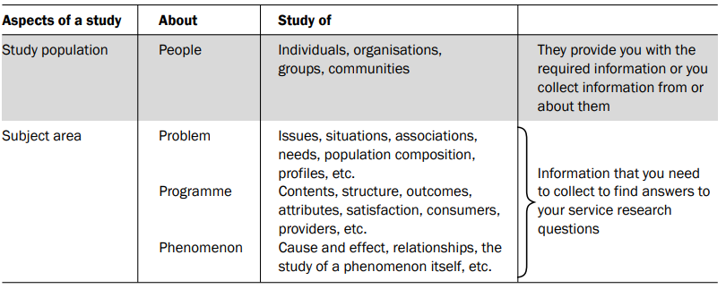
5. Research Problem …
Aspects of a research problem

Slide 25
5. Research Problem …
Consideration in selecting a research problem:
Interest: Interest should be the most important consideration in selecting a research problem.
Magnitude: You should have sufficient knowledge about the research process to be able to visualise the work involved in completing the proposed study. It is extremely important to select a topic that you can manage within the time and with the resources at your disposal.
Measurement of concepts: If you are using a concept in your study (in quantitative studies), make sure you are clear about their measurement. E.g. if you plan to measure the effectiveness of a health promotion programme, you must be clear as to what determines effectiveness and how it will be measured.
Level of expertise: Make sure you have an adequate level of expertise for the task you are proposing.

Slide 26
5. Research Problem …
Consideration in selecting a research problem:
Relevance: Select a topic that is of relevance to you as a professional. Ensure that your study adds to the existing body of knowledge, bridges current gaps or is useful in policy formulation. This will help you to sustain interest in the study.
Availability of data: If your topic entails collection of information from secondary sources (office records, client records, census or other already-published reports, etc.) make sure that this data is available and in the format you want before finalising your topic.
Ethical issues: Another important consideration in formulating a research problem is the ethical issues involved. (Research approval letter, consent from participants, secure data, confidentiality etc)

Slide 27
5. Research Problem …
Steps in formulating a research problem:
Step 1: Identify a broad field or subject area of interest to you. Ask yourself, ‘What is it that really interests me as a professional?’ In the author’s opinion, it is a good idea to think about the field in which you would like to work after graduation.
Step 2: Dissect the broad area into subareas.
Step 3: Select what is of most interest to you. It is neither advisable nor feasible to study all subareas. Out of this list, select issues or subareas about which you are passionate.
Step 4: Raise research questions. At this step ask yourself, ‘What is it that I want to find out about in this subarea?’

Slide 28
5. Research Problem …
Steps in formulating a research problem:
Step 5: Formulate objectives. Both your main objectives and your sub-objectives now need to be formulated, which grow out of your research questions.
Step 6: Assess your objectives. Now examine your objectives to ascertain the feasibility of achieving them through your research endeavour. Consider them in the light of the time, resources (financial and human) and technical expertise at your disposal.
Step 7: Double-check. Go back and give final consideration to whether or not you are sufficiently interested in the study, and have adequate resources to undertake it. Ask youself, ‘Am I really enthusiastic about this study?’ and ‘Do I really have enough resources to undertake it?’ Answer these questions thoughtfully and realistically. If your answer to one of them is ‘no’, reassess your objectives.

Slide 29
6. Research Objectives
Objectives are the goals you set out to attain in your study. Since these objectives inform a reader of what you want to achieve through the study, it is extremely important to word them clearly and specifically.
Objectives should be listed under two headings:
Main Objective: What one hopes to accomplish by the proposed research and must be aligned with the research title.
For Example:
“The main objective of this study is to develop a mobile based application for Covid-19 knowledge sharing in Africa.”

Slide 30
6. Research Objectives …
ii. Specific Objectives: Specific objectives are statements of precise outputs to be achieved within the research time frame and that can be measured in support of the main objective.
Specific objectives should adhere to ‘SMART’ characteristics i.e. Specific (states exactly what will be achieved i.e. what will be done and for whom), Measurable (if it is possible measure or quantify attainment of objective or its results), Achievable (if the objective can be accomplished within the available time frame, resources and support), Relevant (if the objective will have an effect on the desired goal or strategy) and Time-bound (if the objective can be accomplished within a specified time frame).
Provide 3 specific objectives of the study.

Slide 31
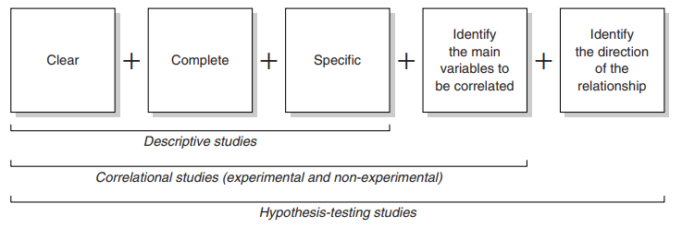
6. Research Objectives …
Characteristics of the wording of research objectives in relation to the type of research study:
If your study is primarily descriptive, your main objective should clearly describe the major focus of your study, even mentioning the organisation and its location unless these are to be kept confidential.
If your study is correlational in nature, the wording of the main objective should also include the main variables being correlated (e.g. to ascertain the impact of migration on family roles or to compare the effectiveness of different teaching methods on the comprehension of students).

Slide 32
7. Research Questions
Research questions or hypothesis are clearly stated.
There is a logical link between the research problem statement and the research questions/hypothesis.
Use research objectives to come up with research questions
Note: You cannot use both research questions and hypotheses.
Formulate Hypotheses with evidences/references (Hypotheses must be formulate in the Literature Review Chapter)

Slide 33

…End…

